Slide 1
Automatic Text Summarization
Abeer Ahmad (38)
Mohammed Deifallah (59)

Slide 2
Outline
Recap
Problem Updates
Model Architecture
Training
Testing
What’s Next?

Slide 3
Recap
We address the text summarization problem, the process of creating a short and coherent version of a longer document.
We follow the single-document generic abstractive approach.
Almost all abstractive models are variations of the Seq2Seq (Encoder-Decoder) network.

Slide 4
Evaluation Metrics
Recall-Oriented Understudy for Gisting Evaluation.
ROUGE-1 refers to the overlap of 1-gram (each word) between the system and reference summaries.
ROUGE-2 refers to the overlap of bigrams between the system and reference summaries.
ROUGE-L: Longest Common Subsequence (LCS) based statistics.
We use ROUGE to evaluate our model.

Slide 5


BLEU VS. ROUGE
Precision-oriented
Proposed in 2002
Formula:
Brevity penalty
Recall-oriented
Inspired from BLEU in 2004
Formula:
Verbosity penalty

Slide 6
State-of-the-Art Models
 | ROUGE-1 | ROUGE-2 | ROUGE-L
Pretraining-Based Model | 41.71 | 19.49 | 38.79
GAN Model | 39.92 | 17.65 | 36.71
Pointer-Generator Model | 39.53 | 17.28 | 36.38

Slide 7
Outline
Recap
Problem Updates
Model Architecture
Training
Testing
What’s Next?

Slide 8
Problem Updates
We drop data preprocessing, except for sentence tokenization.
We use an easier-to-handle dataset, Gigaword, instead of the CNN dataset for our baseline model.
The Gigaword has 3,803,957 training samples and 189,651 test samples, with single-sentence ground truth summaries.
Article: south korea 's nuclear envoy kim sook urged north korea monday to restart work to disable its nuclear plants and stop its `` typical '' brinkmanship in negotiations #
Ground Truth Summary: envoy urges north korea to restart nuclear disablement

Slide 9
Outline
Recap
Problem Updates
Model Architecture
Training
Testing
What’s Next?

Slide 10
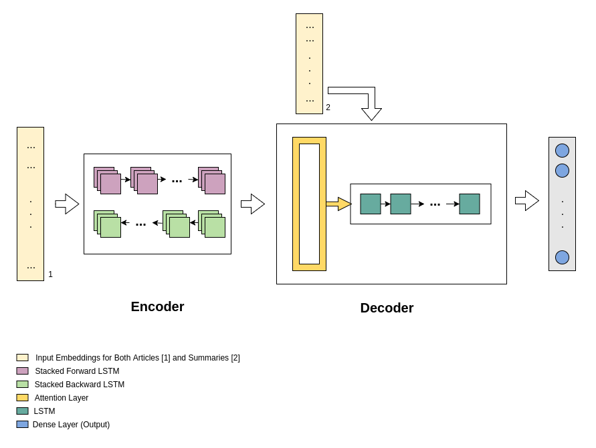
Model Architecture
Encoder
Stacked Bidirectional LSTM with dropout (keep_prop defaults to 0.8)
Decoder
LSTM network with attention

Slide 11
Workflow
Feed a batch of training samples, where each sample is tokenized and each token is represented by its GloVe embedding.
Encode each sample through the encoder network, generating an intermediate output.
Feed the encoder output as input to the decoder network, along with the ground truth summary embeddings.
Use the attention layer to mark a subset of encoder intermediate output vectors that significantly add meaning to the decoder generated summary.
Use a dense layer of the same size as our vocab to generate the most probable word at each timestep.

Slide 12
Outline
Recap
Problem Updates
Model Architecture
Training
Testing
What’s Next?

Slide 13
Training
We train our model with the following configuration:
5-layer stacked LSTM
300-dimensional GloVe embedding vectors
150-unit LSTM cells for the encoder
300-unit LSTM cells for the decoder
We use Adam optimizer, with sparse cross entropy as a loss function.

Slide 14
Outline
Recap
Problem Updates
Model Architecture
Training
Testing
What’s Next?

Slide 15
Outline
Recap
Problem Updates
Model Architecture
Training
Testing
What’s Next?

Slide 16
What’s Next?
Model Improvement for better results on the test set
ROUGE evaluation
Generalizing to the CNN dataset, if possible

